Slide 1

ES6153 Project: Phase 1
Gao Yiyi and Michele Xiloyannis

Slide 2
ES6153 Project: Phase 1
Recursion
Data Structure for recursion
Scheduler
Overflow Managment

Slide 3
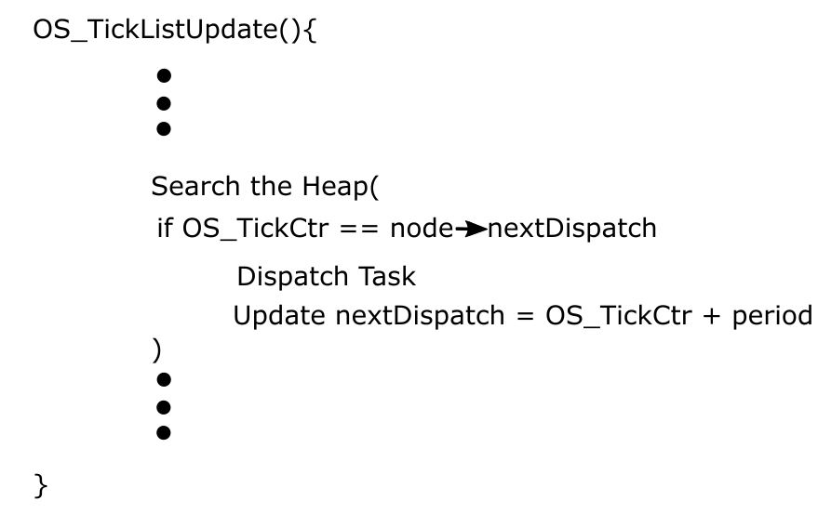
Recursion

Slide 4
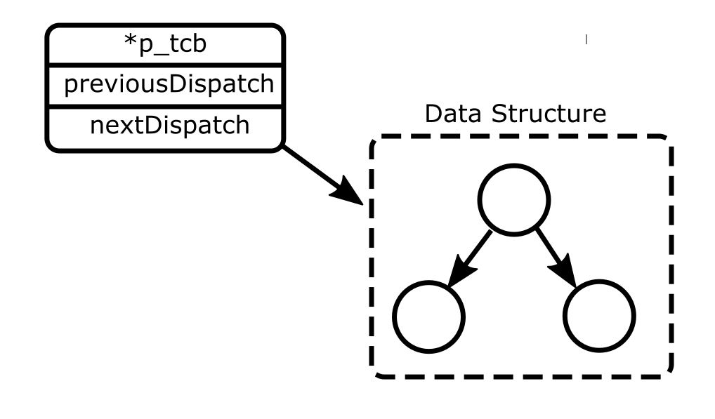
Data Structure for Recursion

Slide 5
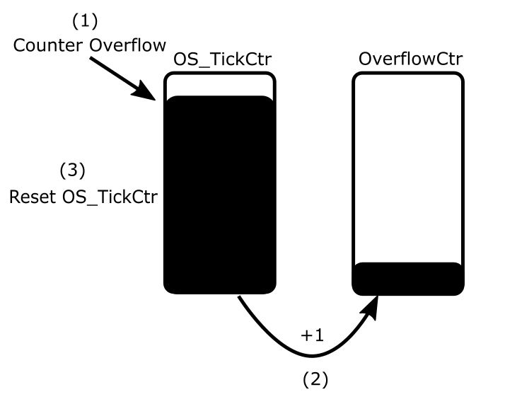
Overflow Management

Slide 6
Thank you

